Slide 1

Department of Computer Science
University Institute of Engineering
DEPARTMENT OF COMPUTER SCIENCE & ENGINEERING
Bachelor of Engineering
Subject Name: System Programming
Subject Code: CST-315
Compilers
DISCOVER . LEARN . EMPOWER

Slide 2
Chapter-1.2 Assembler
Department of computer Science
Multi-Pass Assemblers
Advanced Assembly Process

Slide 3
Multi-Pass Assemblers
If we use a two-pass assembler, the following symbol definition cannot be allowed.
ALPHA EQU BETA
BETA EQU DELTA
DELTA RESW 1
This is because ALPHA and BETA cannot be defined in pass 1. Actually, if we allow multi-pass processing, DELTA is defined in pass 1, BETA is defined in pass 2, and ALPHA is defined in pass 3, and the above definitions can be allowed.
This is the motivation for using a multi-pass assembler.

Slide 4
Multi-Pass Assemblers
It is unnecessary for a multi-pass assembler to make more than two passes over the entire program.
Instead, only the parts of the program involving forward references need to be processed in multiple passes.
The method presented here can be used to process any kind of forward references.
Use a symbol table to store symbols that are not totally defined yet.
For a undefined symbol, in its entry, – We store the names and the number of undefined symbols which contribute to the calculation of its value. – We also keep a list of symbols whose values depend on the defined value of this symbol.
When a symbol becomes defined, we use its value to reevaluate the values of all of the symbols that are kept in this list.
The above step is performed recursively.

Slide 5
Multi-Pass Assemblers
Examples
Microsoft MASM Assembler, Sun Sparc Assembler, IBM AIX Assembler
Microsoft MASM Assembler
SEGMENT - a collection segments, each segment is defined as belonging to a particular class, CODE, DATA, CONST, STACK
registers: CS (code), SS (stack), DS (data), ES, FS, GS
similar to program blocks in SIC l ASSUME
e. g. MOVE ES: DATASEG 2 AX, DATASEG 2 ES, AX » similar to BASE in SIC 11

Slide 6
Multi-Pass Assemblers
lMicrosoft MASM Assembler (Contd.)
JUMP with forward reference
near jump: 2 or 3 bytes
far jump: 5 bytes
e. g. JMP TARGET
Warning: JMP FAR PTR TARGET
Warning: JMP SHORT TARGET
Pass 1: reserves 3 bytes for jump instruction phase error PUBLIC, EXTRN
similar to EXTDEF, EXTREF in SIC 12

Slide 7
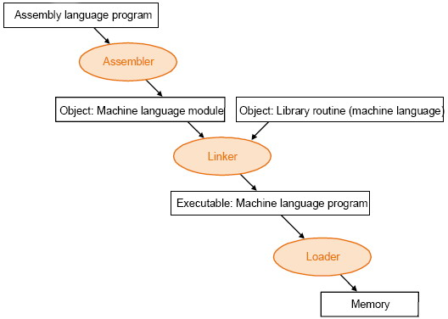
Advanced Assembly process

Slide 8
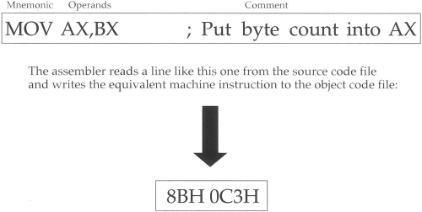
Advanced Assembly Process (Example)

Slide 9
Advanced Assembly Process
Assembling
At assembly time, the assembler:
Evaluates conditional-assembly directives, assembling if the conditions are true.
Expands macros and macro functions.
Evaluates constant expressions such as MYFLAG AND 80H, substituting the calculated value for the expression.
Encodes instructions and non address operands. For example, mov cx, 13; can be
encoded at assembly time because the instruction does not access memory.
Saves memory offsets as offsets from their segments.
Places segments and segment attributes in the object file.
Saves placeholders for offsets and segments (relocatable addresses).
Outputs a listing if requested.
Passes messages (such as INCLUDELIB) directly to the linker.

Slide 10
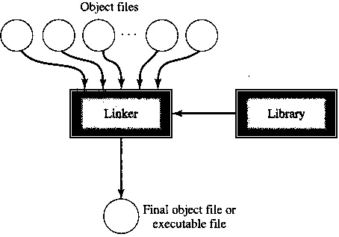
Advanced Assembly Process
Linking
Once your source code is assembled, the resulting object file is passed to the linker. At this point, the linker may combine several object files into an executable program. The linker: Combines segments according to the instructions in the object files, rearranging the positions of segments that share the same class or group. Fills in placeholders for offsets (relocatable addresses). Writes relocations for segments into the header of .EXE files (but not .COM files). Writes the result as an executable program file.

Slide 11
Advanced Assembly Process
Loading
After loading the executable file into memory, the operating system:
Creates the program segment prefix (PSP) header in memory.
Allocates memory for the program, based on the values in the PSP.
Loads the program.
Calculates the correct values for absolute addresses from the relocation table.
Loads the segment registers SS, CS, DS, and ES with values that point to the proper areas of memory.

Slide 12
Advanced Assembly Process
Useful Tools and Utilities
DUMPBIN disassembly program
Debuggers: OllyDbg and WinDbg
Consol I/O: iolib.

Slide 13
References
Department of computer Science
[PDF] Systems Programming and Operating Systems by Dhamdhere - Free Download PDF (dlscrib.com)
[PDF] Principles of Compiler Design By Alfred V. Aho & J.D.Ullman Free Download – Learnengineering.in

Slide 14
THANK YOU

